Slide 1
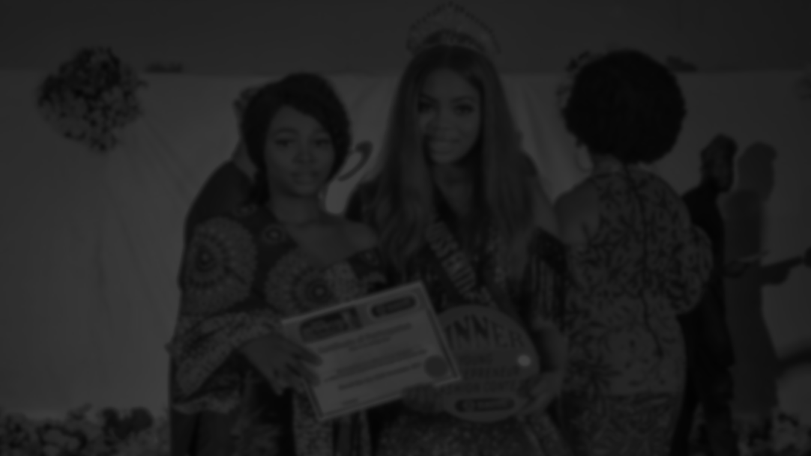

EKITI FASHION
EXHIBITION
PROFILE

Slide 2
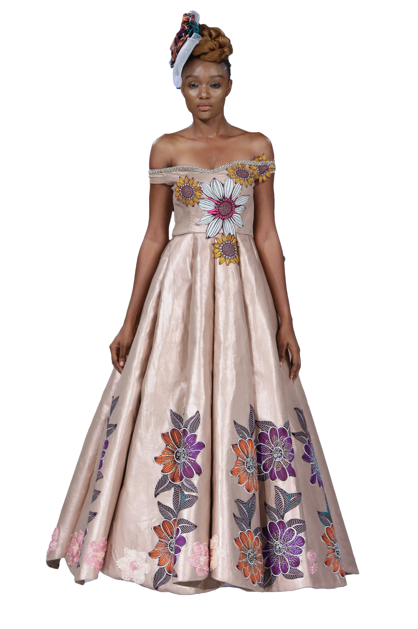
ABOUT EKITI FASHION EXHIBITION (EFE)
With increasing number of youths plunging into depression and crime, there is no better time than now to empower the youths to become self-reliant and active ambassadors of Nigeria. The fashion industry can be a pathway to eventuating such an agenda. Ekiti Fashion Exhibition is an annual event that promotes fashion brands, empower the youths and expand the state's fashion industry through skill acquisition programs and fashion exhibition shows. Ekiti Fashion Exhibition is organized by De Elegant Expertise Palais, a fashion brand based Ekiti State, Nigeria.
Running for 8 years now, the 9th edition is scheduled to hold in Ado-Ekiti this year. We are aware that a selfless vision as this would require the partnership with the state, organisations, individuals and cooperation of the people.
To this end De Elegant Expertise Palais has deemed it fit to empower young people who have been equipped with fashion skills by empowering their brand with a start up plan. The winner of the Ekiti young Fashionprenuer contests was given a well equipped space and her rent was paid for. The first runner up was given a complete Electric/Manual Machine, while the second runner up was given a Mini Electric Machine.

Slide 3
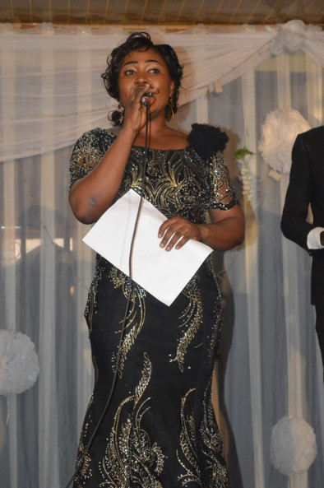
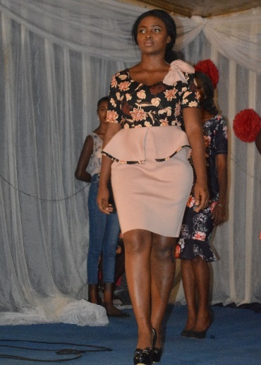
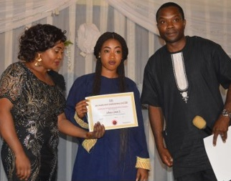
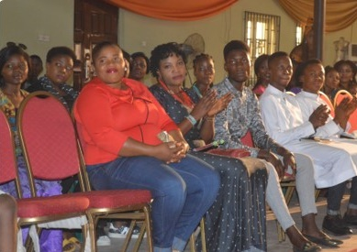
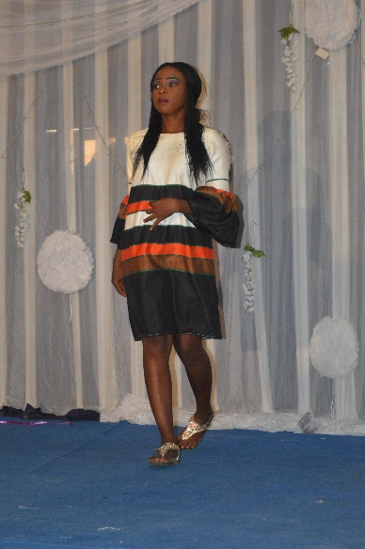
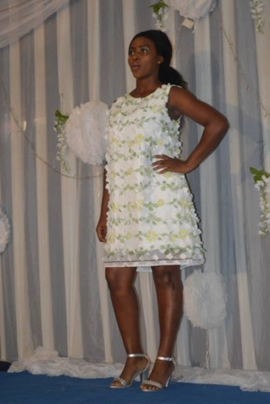
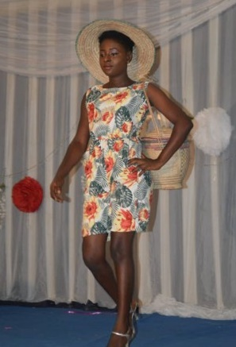
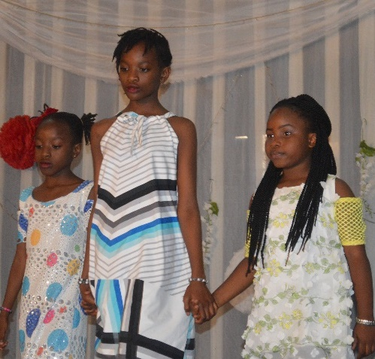
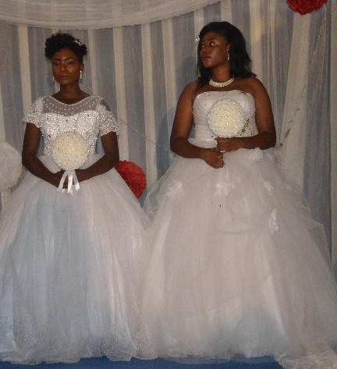
PRESENTATION OF CERTIFICATE BY REPRESENTATIVE OF AARE AFE BABALOLA AND THE CONVENER
INTIVED GUEST AT EFE 2017
THE CONVENER GIVING A SPEECH
MODELS ON THE RUN WAY
EKITI
FASHION
EXIBITION
2017
KIDDIES MODELS ON THE RUN WAY
MODELS ON THE RUN WAY

Slide 4
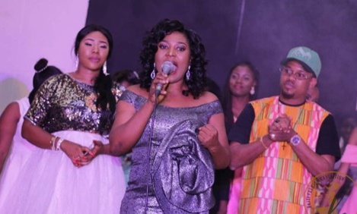
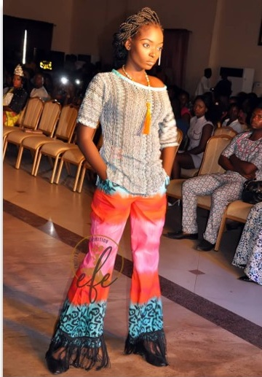
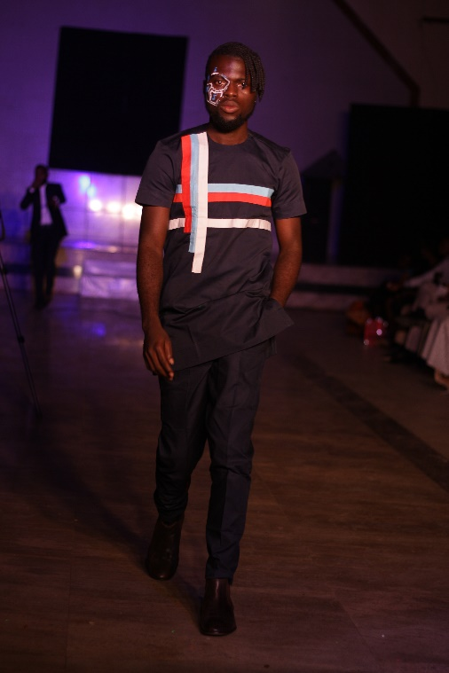
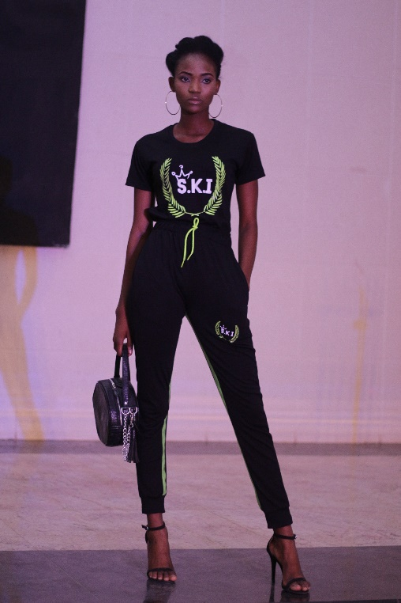
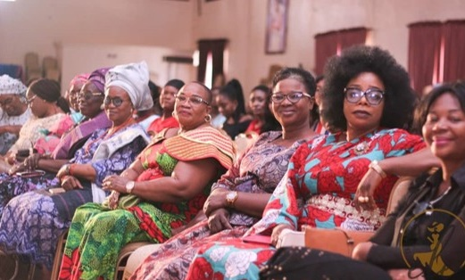
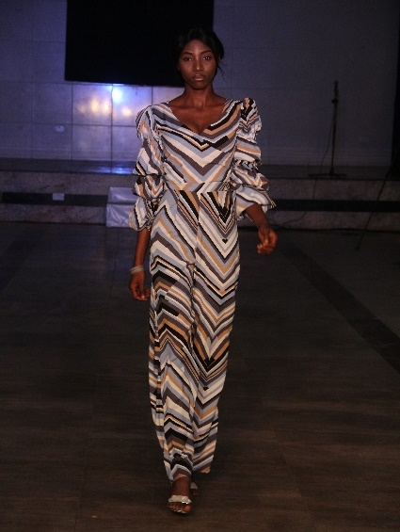
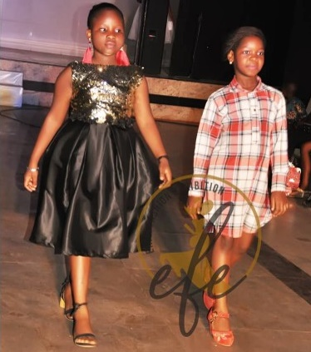
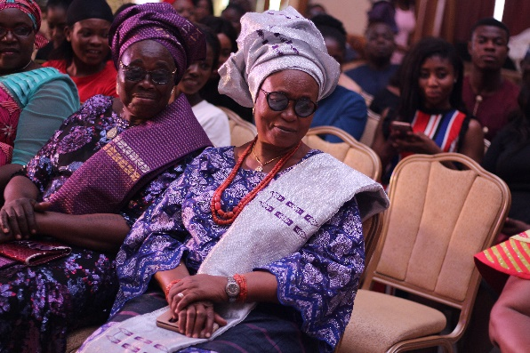
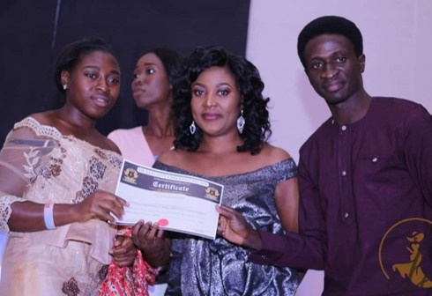
THE CONVENER GIVING HER INTRODUCTORY SPEECH
MODELS ON THE RUN WAY
INTIVED GUEST AT EFE 2018
EKITI
FASHION
EXIBITION
2018
SPECIAL GUEST OF HONOUR: EYESORUN ABOSEDE ADEJUGBE
PRESENTATION OF CERTIFICATE AWARD AND FUNDS
MODELS ON THE RUN WAY
KIDDIES MODELS ON THE RUN WAY

Slide 5
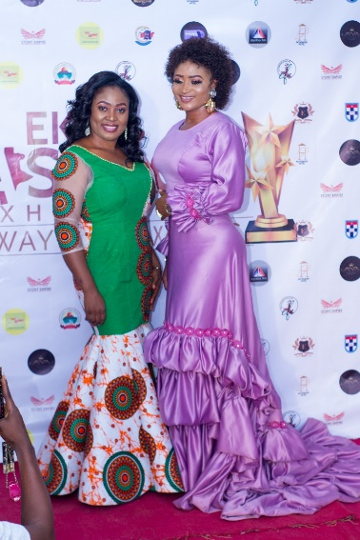
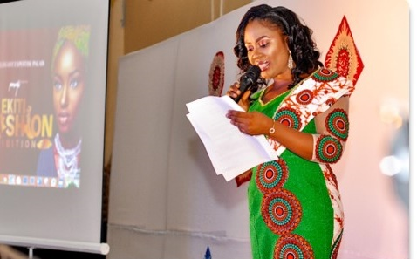
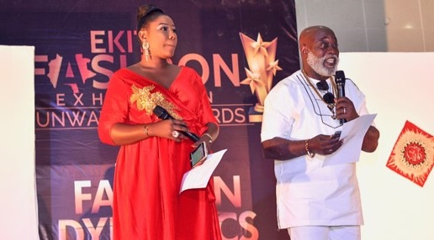
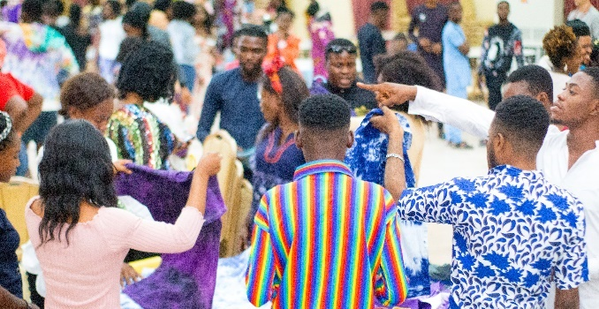
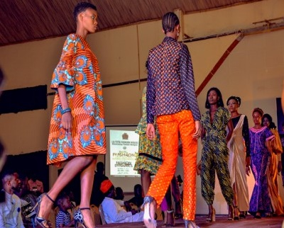
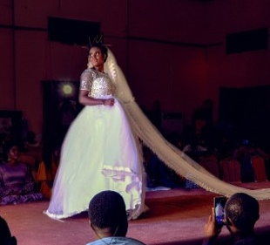
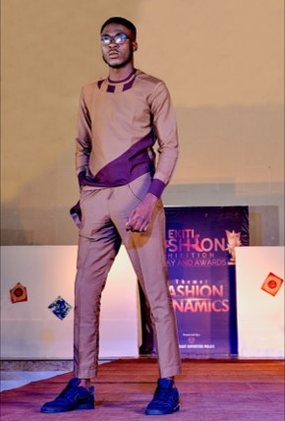
THE CONVENER GIVING HER INTRODUCTORY SPEECH
HOST AND CO HOST ( DGURL & JIBOLA DABO )
EXHIBITION AND SALES
THE CONVENER AND
CEO LUMINEE
EKITI
FASHION
EXIBITION
2019
MODEL ON THE RUN WAY
MODELS ON THE RUN WAY

Slide 6
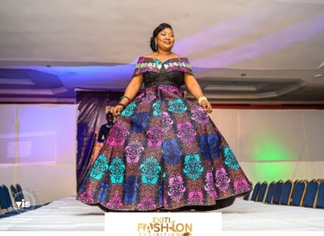
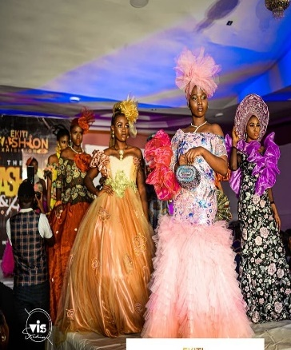
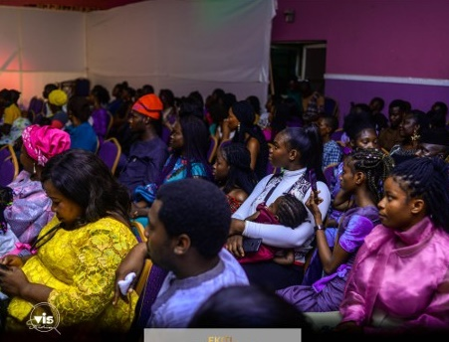
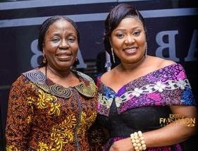
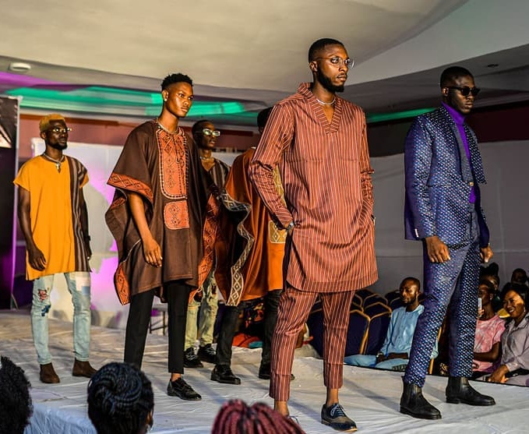
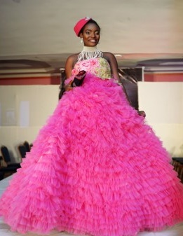
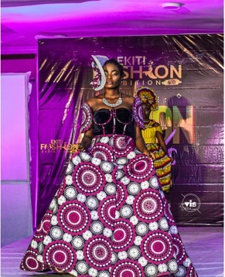
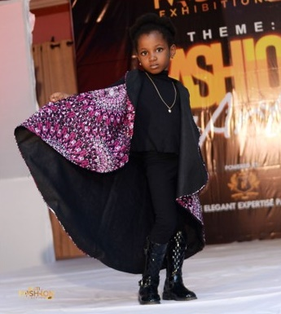
THE CONVENER ON THE RUNWAY
THE MODELS ON THE RUNWAY
GUEST AT THE EVENT
EKITI HEAD OF SERVICE WITH THE CONVENER
EKITI
FASHION
EXIBITION
2020
MODELS ON THE RUN WAY
KIDDIES MODEL ON THE RUN WAY

Slide 7
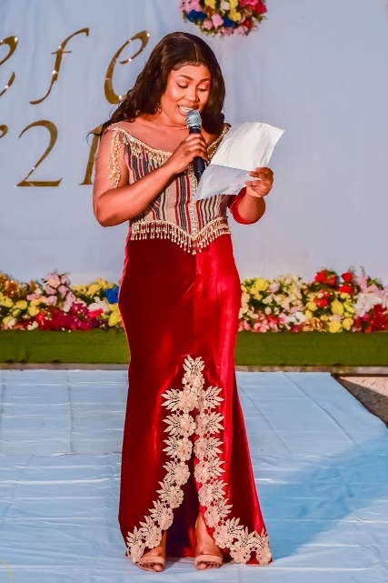
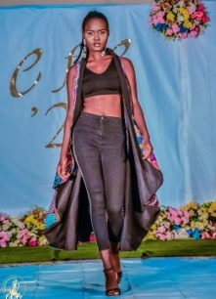
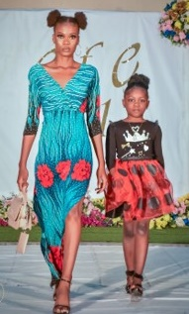
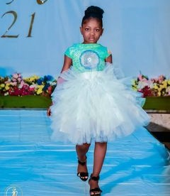
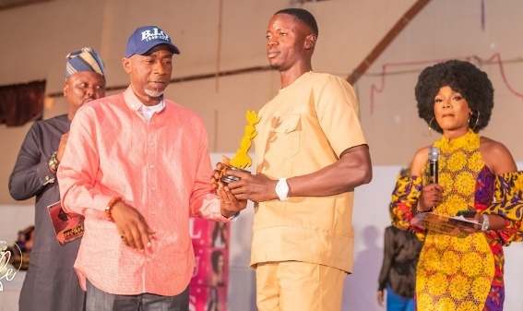
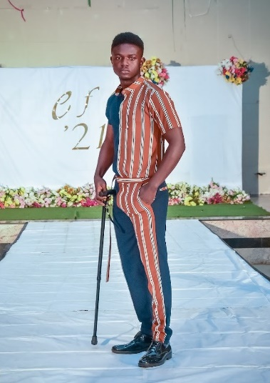
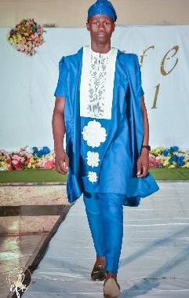

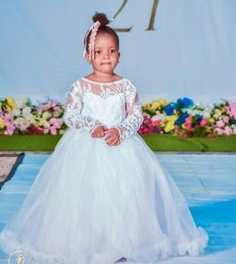

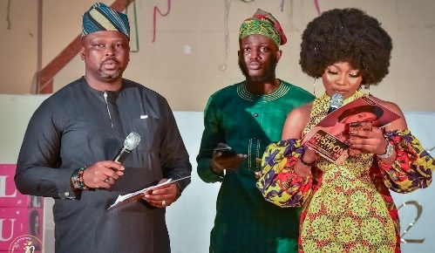
CLOTHES ON HANGER
KIDDES MODEL ON THE RUN WAY
THE CONVENER GIVING A SPEECH
MODEL ON THE RUN WAY
MODELS ON THE RUN WAY
PRESENTATION OF AWARDS
EKITI
FASHION
EXIBITION
2021
MODELS ON THE RUN WAY
KIDDES MODEL ON THE RUN WAY
HOST: TAIWO IBIKUNLE & SIMI WILLIAMS AT THE EVENT GIVING A SPEECH

Slide 8
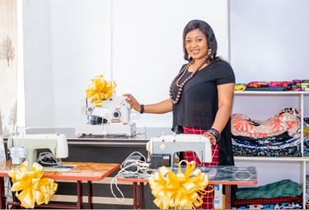
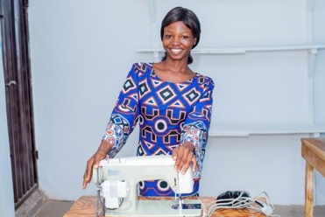

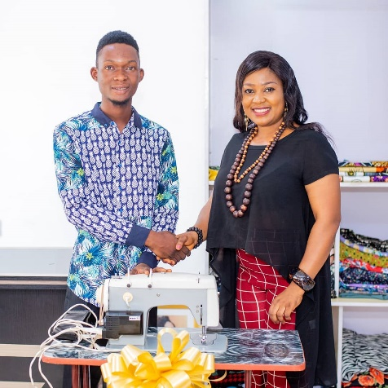

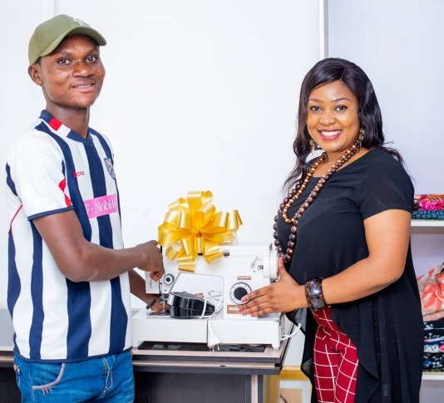
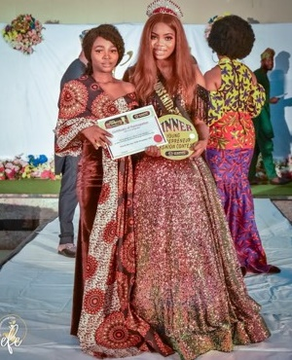
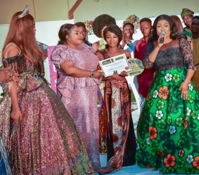

EKITI YOUNG FASHIONPRENUER CONTEST 2021
CONVENER WITH GIFTS
PRESENTATION OF SEWING MACHINE & A SHOP TO THE WINNER
1ST RUNNER UP WON A COMPLETE ELECTRIC/
MANUAL MACHINE
SECOND RUNNER-UP WON AN ELECTRIC HEAD MACHINE
DECLARATION OF
WINNER
WINNER WITH FOLUKE
DARAMOLA
SCREENING OF THE CONTESTANT

Slide 9








PRESENTATATION OF PRIZES

Slide 10




TRAINING IN PROGRESS
SKILL
ACQUISITION
TRAINING
SEWING LECTURES IN PROGRESS

Slide 11
FOCUS AREA
01
03
Entrepreneurship
Focus Area
Focus Area
Fashion Exhibition & Arts
02
Excellence in Fashion Industry
Focus Area

Slide 12

BACKGROUND
Youths in Ekiti State constitutes a part of the Nigeria youth unemployment figure that presently stand at 23.69%. This figure threatens the society as victims of this hazardous situation that has made a lot of young persons plunge into criminal activities. A good way to reduce this figure as well as curb the menace that comes with it is to empower the youths through skill acquisition. Youth empowerment comes with no cons: but it benefits both the youths and host state. In other words, youth empowerment are greatly beneficial to societies that takes it seriously and do it rightly.
De-Elegant Expertise Palais (DEEP)--a fashion enterprise based in Ekiti state has in the last five years committed its strength not only to the business of fashion but to empowering youths of Ekiti state through its annual event, EKITI FASHION EXHIBITION. We do this convinced of the immense benefit of fashion to youths and state. Empowering youth in fashion would make them self-employed; thus, help them to be less dependent on the state for sustenance. The state also can explore this area of untapped area in her pursuit to expand the economy. We have examples of cities across the world who have engaged the riches of the fashion industry and have grown their economy in so doing. Paris is a city as such: having fashion contributing 2.7% share to her GDP and created jobs for over 1million individuals.

Slide 13

OBJECTIVES
Making Ekiti State a Fashion of Nigeria
Sell products at bonanza price as part of the benefits to attendees
Promote the sponsors of the programme and all their services
Promote Fashion brands and other business in Ekiti
Business in Ekiti are been promoted outside / around Nigeria.
Partners products and services will always be on our official website.
To ease means of doing business, partners products and services will be displayed virtually during the event and after.
During the event, acknowledging the partners will be made on stage.
Raise fashionistas with creativity and great taste for fashion designing
Promote fashion artisans with their services in the society
Advance professionalism in fashion trends among fashion designers
Help build and maintain stable livelihood without limitation
Reduce social vices through youth empowerment in fashion designing

Slide 14

OUR VISION
DEEP has a vision to raise a host of innovative fashion creatives with a sense of purpose and fulfilment, and develop individuals to be self-reliant and embrace the ideal of helping others in actualising their dreams.
OUR MISSION
To initiate fashion trends; expand the fashion industry; raise goodwill fashion ambassadors; empower youngsters through fashion seminars and workshops; and promote local fashion brands through fashion show exhibitions in the state.

Slide 15


IMPACT
EFE is in its 8th year and has the ambition to be a foremost fashion event in Nigeria within the next Five years
6000+
2000+
20000+
The event in the last eight years has empowered at least
6000 Ekiti youths directly through scholarships, free fashion related skill acquisition and modelling deals
supported over 2000 fashion brands through brand exhibition
attracted over more than 20000 audience

Slide 16

ABOUT THE CONVENER
Oluwabusayo Owajoba is the CEO of De Elegant Expertise Palais, a fashion house based in Ado-Ekiti, Ekiti state.
Elegant as she is popularly called, hails from Emure-Ekiti, Ekiti State, Nigeria. She bagged BSC in Accounting at the
prestigious Ekiti State University. In 2017, she launched the First ever fashion event "Ekiti Fashion Exhibition" in Ado-Ekiti, Ekiti state, under her fashion brand ''De Elegant Expertise Palais'' which featured over 200 fashion designers showcased
and promoted their designs. The events attracted big brands like ABUAD, Coca-Cola, Lush Hair etc.
The second edition of the show which featured presentation of awards held in 2018 and it attracted numerous talented
designers, models and fashion entrepreneurs within and outside the state. The event has since grown to become an
iconic platform for fashion entrepreneurs to showcase their designs, wears and accessories in Ekiti during its exhibition & runway which has become an annual event and has had eight editions so far. Oluwabusayo Owajoba was appointed has
Member of Technical Committee EKIFEST 2019. She was also appointed as a Member of the Mobilizing Committee for the Ekiti Entrepreneurship Week 2019. Since 2020 till now she has served as a Fashion Consultant and Fashion Designer to the Ekiti State Ministry of Arts and Culture for the NAFEST Fashion Competition — a prestigious annual event held across the
Federation.
Through her unwavering creativity and exceptional sense of style, Ekiti State has consistently excelled in the
fashion category, earning national recognition. Among the 36 states of the Federation, including the Federal Capital
Territory, Ekiti State took 1st position in 2021, 1st position in 2022, 2nd position in 2023, and reclaimed 1st position in
2024. Her outstanding contributions have not only elevated Ekiti’s profile in the national fashion scene but have also
affirmed the state’s leadership in cultural excellence through fashion. In 2021, she was appointed as an Assistant Project
Supervisor of FADAN (Fashion Designer Association of Nigeria). In 2023, she was also appointed has Member of Business
Advisory Board of Enactus, Bamidele Olumilua University of Education, Science and Technology, Ikere-Ekiti
(BOUESTI)
Apart from being passionate about showcasing genuis of Fashion Enterprenuers in Nigeria to the World, Oluwabusayo
Busayo is also committed to give back society and acknowledging excellence. Hence, She officially launched an in the year 2021 Young Fashionpreneur Contest (YFC) which has hosted 100 young fashionprenuers. Ever since, this avenue has been serving as one where young entrepreneurs contest through the quality of their products and are empowered as a form of encouragement.

Slide 17

ABOUT THE CONVENER
During the First, Second and Third Edition of YFC, Sets of Sewing Machine, Cash Prizes and Fully-Paid Fashion Store were
given to the winners of Fashion contest, among others.
AWARD RECIEVED
Fashion Designer of the year, Are Afe Babalola Beneficiaries Worldwide 2022
Fashion Designer of the year, Ekiti Future Awards 2022
Certificate of Appreciation for Voluntary and Meritious services as an ASSESSOR at Ekiti Enterprise Challenges 2024
Award of Recognition for immense contribution and support to the progress The Directorate of Educational Technology,
Innovation and Entrepreneurship (DETIE), Federal University of Oye-Ekiti (FUOYE)

Slide 18







CORE TEAM MEMBERS
ENGR. DOTUN AJAO
CONSTANCHEM DADA
KEMISOLA RAJI
Chairman Committee
Project Coordinator
Welfare Manager
OWAJOBA BUSAYO
Convener Ekiti Fashion Exhibition
EMMANUEL OMOLAYO
BABAJIDE FAJUYI
PRISCA OGUNLADE
Project Coordinator
Media/Publicty
PRO

Slide 19






SPONSORS & PARTNERS
1
2
3
6
4
5

Slide 20

Thank You

